Slide 1


Huffman Coding
A famous Greedy Algorithm.

Slide 2


It is used for the lossless compression of data.
It uses variable length encoding.
The code length of a character depends on how frequently it occurs in the given text.
The character that occurs most frequently gets the smallest code.
The character that occurs least frequently gets the largest code

Slide 3
Prefix Rule
Huffman Coding implements a rule known as a prefix rule.
This is to prevent the ambiguities while decoding.
It ensures that the code assigned to any character is not a prefix of the code assigned to any other character.

Slide 4
Major steps in Huffman Coding
Building a Huffman Tree from the input characters.
1
Assigning code to the characters by traversing the Huffman Tree.
2

Slide 5


Huffman Tree
The steps involved in the construction of Huffman Tree are as follows

Slide 6
Step 1
Create a leaf node for each character of the text.
Leaf node of a character contains the occurring frequency of that character.

Slide 7

Step 2
Arrange all the nodes in increasing order of their frequency value.

Slide 8
Step 3
Considering the first two nodes having minimum frequency,
Create a new internal node.
The frequency of this new node is the sum of frequency of those two nodes.
Make the first node as a left child and the other node as a right child of the newly created node.

Slide 9
Step 4
Keep repeating Step-02 and Step-03 until all the nodes form a single tree.
The tree finally obtained is the desired Huffman Tree.

Slide 10
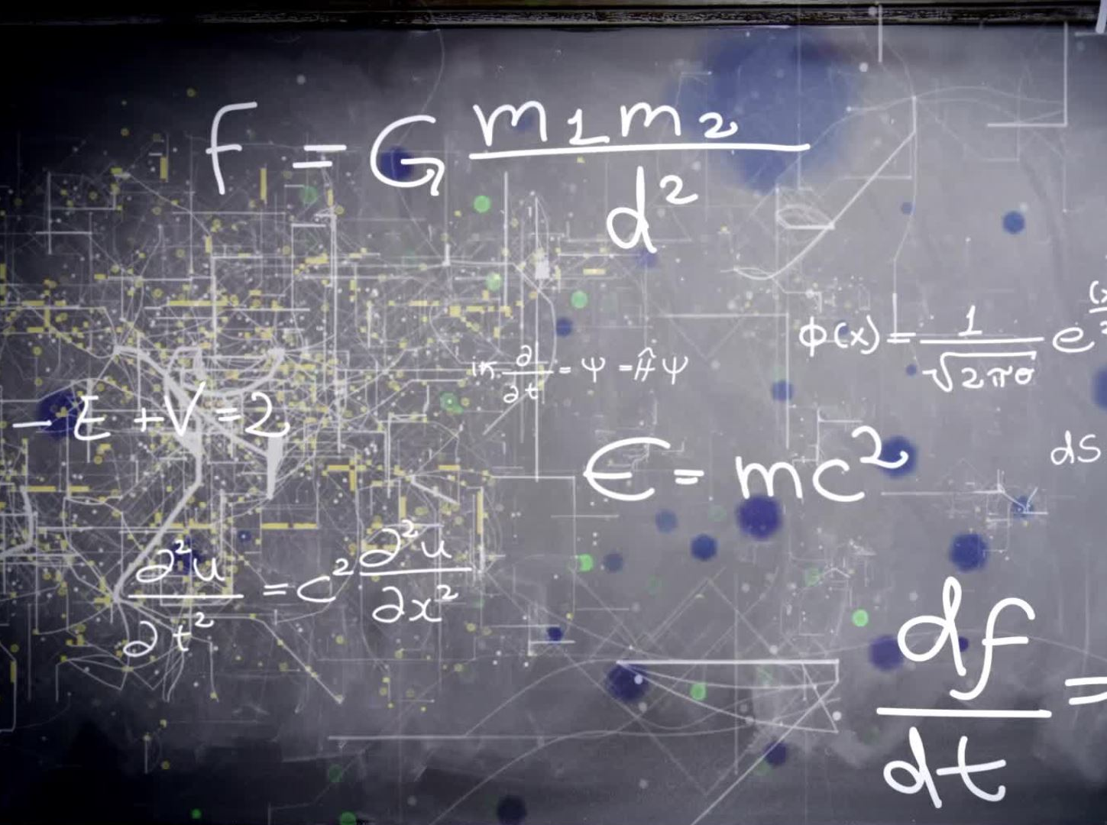
Time Complexity
The time complexity analysis of Huffman Coding is as follows-
extractMin( ) is called 2 x (n-1) times if there are n nodes.
As extractMin( ) calls minHeapify( ), it takes O(logn) time.
Thus, Overall time complexity of Huffman Coding becomes O(nlogn).
Here, n is the number of unique characters in the given text.

Slide 11
Example Based on Huffman's Coding Algo.
A file contains the following characters with the frequencies as shown. If Huffman Coding is used for data compression, determine-
Huffman Code for each character
Average code length
Length of Huffman encoded message (in bits)

Slide 12
Example
Build the Huffman coding tree for the message
Character frequencies
Begin with forest of single trees
A | G | M | T | E | H | _ | I | S
1 | 1 | 1 | 1 | 2 | 2 | 3 | 3 | 5
1
1
1
1
2
2
3
3
5
A
G
M
T
E
H
_
I
S
Notes:
Step1: Create and initialize a PriorityQueue consisting of each unique character.
Step2: Sort in ascending order of their frequencies.
Step3: for all the unique character:
create
get minimum_value frow Queue and set it to left to child of new_node
get minimum_value from Queue and set it to right child of new_node
Step4: calculate the sum of these two minimum values as sum_of_two_minimum
Step5: assign sum_of_two_minimum to the value of new_node
Step6: insert new_node into the tree
Step7: return root_node

Slide 13
Step 1
2
1
1
1
1
2
2
3
3
5
A
G
M
T
E
H
_
I
S

Slide 14
Step 2
2
2
1
1
1
1
2
2
3
3
5
A
G
M
T
E
H
_
I
S

Slide 15
Step 3
2
2
4
1
1
1
1
2
2
3
3
5
A
G
M
T
E
H
_
I
S

Slide 16
Step 4
4
2
2
4
1
1
1
1
2
2
3
3
5
A
G
M
T
E
H
_
I
S

Slide 17
Step 5
4
2
2
4
6
1
1
1
1
2
2
3
3
5
A
G
M
T
E
H
_
I
S

Slide 18
Step 6
8
4
4
2
2
2
2
6
E
H
1
1
1
1
3
3
5
A
G
M
T
_
I
S

Slide 19
Step 7
8
11
4
4
6
5
S
2
2
2
2
3
3
E
H
_
I
1
1
1
1
A
G
M
T

Slide 20
Step 8
19
8
11
4
4
6
5
S
2
2
2
2
3
3
E
H
_
I
1
1
1
1
A
G
M
T

Slide 21


Now
Rule If you assign weight ‘0’ to the left edges, then assign weight ‘1’ to the right edges. If you assign weight ‘1’ to the left edges, then assign weight ‘0’ to the right edges. Any of the above two conventions may be followed. But follow the same convention at the time of decoding that is adopted at the time of encoding.

Slide 22
Label edges
19
0
1
8
11
0
1
0
1
4
4
6
5
0
1
0
1
0
1
S
2
2
2
2
3
3
0
1
0
1
E
H
_
I
1
1
1
1
A
G
M
T

Slide 23
Huffman code & encoded message
This is message
S 11
E 010
H 011
_ 100
I 101
A 0000
G 0001
M 0010
T 0011
00110111011110010111100011101111000010010111100000001010

Slide 24
Practice Problem
Character | Frequencies
a | 10
e | 15
i | 12
o | 3
u | 4
s | 13
t | 1

Slide 25

Solution

Slide 26

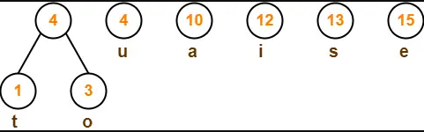
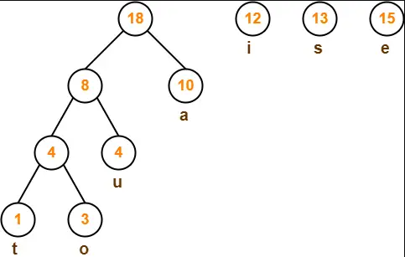
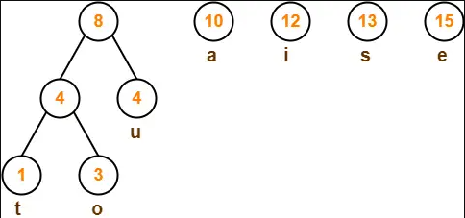

Slide 27
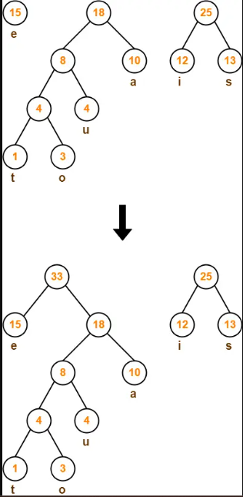
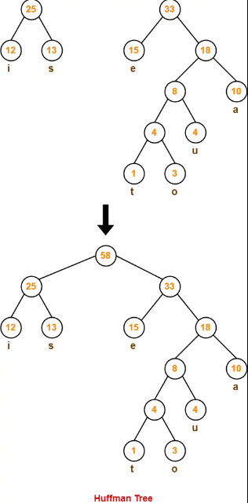
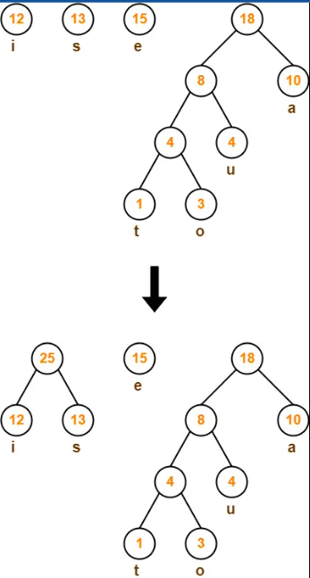

Slide 28
What is the sequence of characters corresponding to the following code. 01 110 01 110 01 00 01
Character | Frequencies
A | 6
B | 2
C | 2
D | 2
E | 2
F | 5

Slide 29
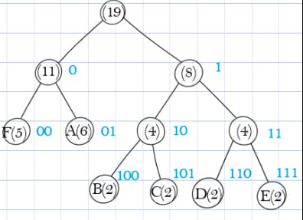
Here is the Tree

Slide 30

Thank You
RADHE RADHE

Slide 31
Step1: Create and initialize a PriorityQueue consisting of each unique character.
Step2: Sort in ascending order of their frequencies.
Step3: for all the unique character:
create
get minimum_value frow Queue and set it to left to child of new_node
get minimum_value from Queue and set it to right child of new_node
Step4: calculate the sum of these two minimum values as sum_of_two_minimum
Step5: assign sum_of_two_minimum to the value of new_node
Step6: insert new_node into the tree
Step7: return root_node

